Slide 1
Big Data Analytics
Academic English

Slide 2
Part I: Introduction

Slide 3
WHAT IS THE BIG DATA ANALYTICS ?

Slide 4
Big data analytics is the process of examining large data sets containing a variety of data types

Slide 5
Purpose
To uncover hidden patterns, unknown correlations, market trends, customer preferences and other useful business information.

Slide 6
Can it do ?
Lead to more effective marketing, new revenue opportunities, better customer service, improved operational efficiency, competitive advantages over rival organizations and other business benefits.

Slide 7
Primary goal
Help companies make more informed business decisions by enabling data scientists, predictive modelers and other analytics professionals to analyze large volumes of transaction data, as well as other forms of data that may be untapped by conventional business intelligence (BI) programs.

Slide 8
Include
Web server logs and Internet clickstream data, social media content and social network activity reports, text from customer emails and survey responses, mobile-phone call detail records and machine data captured by sensors connected to the Internet of Things.

Slide 9
Advanced analytics
Big data can be analyzed with the software tools commonly used as part of advanced analytics disciplines such as predictive analytics, data mining, text analytics and statistical analysis. Mainstream BI software and data visualization tools can also play a role in the analysis process.

Slide 10
Technologies
Hadoop and related tools such as YARN, MapReduce, Spark, Hive and Pig as well as NoSQL databases. Those technologies form the core of an open source software framework that supports the processing of large and diverse data sets across clustered systems.

Slide 11
Hadoop
In some cases, Hadoop clusters and NoSQL systems are being used as landing pads and staging areas for data before it gets loaded into a data warehouse for analysis, often in a summarized form that is more condutive to relational structures.
In such architectures, subsets of the data can then be filtered for analysis in data warehouses and analytical databases, or it can be analyzed directly in Hadoop using batch query tools, stream processing software and SQL on Hadoop technologies that run interactive, ad hoc queries written in SQL.

Slide 12
Challenge
For most organizations, big data analysis is a challenge. Consider the sheer volume of data and the different formats of the data (both structured and unstructured data) that is collected across the entire organization and the many different ways different types of data can be combined, contrasted and analyzed to find patterns and other useful business information.
The first challenge is in breaking down data silos to access all data an organization stores in different places and often in different systems. A second big data challenge is in creating platforms that can pull in unstructured data as easily as structured data. This massive volume of data is typically so large that it’s difficult to process using traditional database and software methods.

Slide 13
Part II: Formation and development

Slide 14
Why do we need analyzing big data ?

Slide 15
Big Data Requires High-Performance Analytics
To analyze such a large volume of data, big data analytics is typically performed using specialized software tools and applications for predictive analytics, data mining, text mining, forecasting and data optimization. Collectively these processes are separate but highly integrated functions of high-performance analytics. Using big data tools and software enables an organization to process extremely large volumes of data that a business has collected to determine which data is relevant and can be analyzed to drive better business decisions in the future.

Slide 16
Why is big data analytics important ?

Slide 17
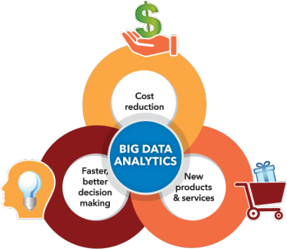
Benefits
Cost reduction. Big Data technologies such as Hadoop and cloud-based analytics bring significant cost advantages when it comes to storing large amounts of data – plus they can identify more efficient ways of doing business.
Faster, better decision making. With the speed of Hadoop and in-memory analytics, combined with the ability to analyze new sources of data, businesses are able to analyze information immediately – and make decisions based on what they’ve learned.
New products and services. With the ability to gauge customer needs and satisfaction through analytics comes the power to give customers what they want. Davenport points out that with big data analytics, more companies are creating new products to meet customers’ needs.

Slide 18
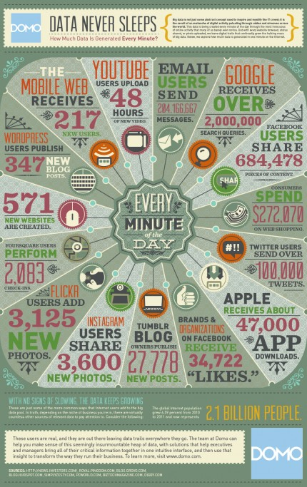
How Big Data Analytics is Used Today ?

Slide 19
Who’s using it ?
Think of a business that relies on quick, agile decisions to stay competitive, and most likely big data analytics is involved in making that business tick. Here’s how different types of organizations might use the technology:
Travel and hospitality
Health care
Government
Retail

Slide 20
How It Works ?
There’s no single technology that encompasses big data analytics. Of course, there’s advanced analytics that can be applied to big data, but in reality several types of technology work together to help you get the most value from your information. Here are the biggest players:
Data management
Data mining
Hadoop
In-memory analytics
Predictive analytics
Text mining

